Slide 1
CE2001/ CZ2001: Algorithms
Graphs
Ke Yiping, Kelly
Notes:
In this lecture, we are going to learn a very exciting topic in algorithms with many applications, and that is, the algorithms about graphs.

Slide 2
Table of Contents
Graph Terminology
Graph Representations
Graph Traversal
Breadth First Search
Depth First Search
Backtracking
Greedy Algorithms
Shortest Path (Dijkstra's Algorithm)
Minimum Spanning Tree (Prim's Algorithm)
Notes:
This is the outline of this module on graphs algorithms. First, we need to be familiar with the graph terminology. It is the vocabulary for technical communication about graphs.
Secondly, we will learn how to represent a graph inside a computer, where we will see what kind of data structures we can use to represent a graph.
Then, we will learn the most basic algorithms about graphs, for solving the problem of) graph traversal. Two algorithms of graph traversal will be learned.
One is Breadth First Search and the other is Depth First Search. Just like there are three orders of tree traversal, which are pre-order, in-order and post-order, the two algorithms discussed here explore a graph systematically in different orders.
Then, we will learn an application of Depth first search in artificial intelligence; it is called Backtracking.
The last part is the greedy algorithms. This is another strategy for algorithm design.
We will learn how to find the shortest path in a graph using the Dijkstra’s algorithm,
and also how to find the minimum spanning using the Prim’s algorithm. These are two optimization problems solved by greedy algorithms.

Slide 3
Graph Terminology
Notes:
To begin with, let us first learn the graph terminologies, which form the foundation for learning the graph algorithms.
Just like memorizing the English alphabet is the first step of learning English, learning graph terminologies is prerequisite
for understanding graph algorithms.

Slide 4
Learning Objectives
At the end of this lecture, students should be able to:
Use graph terminologies accurately
Explain and use basic graph representation methods:
Adjacency matrix
Array of adjacency lists
Compare the strengths and weaknesses between the two graph representation methods
Notes:
This lecture is about the basic concepts of graphs and how to represent graphs in computers.
At the end of the lecture, we should be able to do the following.
First, after learning the graph terminologies, we should be able to use them accurately in the technical communications about graphs.
In other words, the terminologies should be part of our English vocabulary.
<<animation 1>>Secondly, we will learn two methods to represent graphs in computers.
<<animation 2>>One is the adjacency matrix, and the other is the array of adjacency lists.
We should be able to explain their definitions, and use them to encode a given graph in the programming.
An exercise is that, for a given graph drawn on a paper, can you write out the corresponding adjacency matrix
and the array of adjacency lists?
<<animation 3>>Moreover, we will compare the two methods of representation, in terms of time and space efficiencies.
In the future, under different conditions in real-life applications, you should be able to choose the more
efficient method between the two methods for graph representation.

Slide 5
Graph Terminology
A graph G is defined formally as G = (V, E)
V is a set of vertices
vertex also called node, point
notation: V = {V₁, V₂ , . . . , V_{n}}
A
B
C
D
Notes:
First, let us go through the graph terminology, which you probably have learned in the course of Discrete Mathematics. A graph G is defined by two sets, V and E.
V is the set of vertices. “Vertices” is the plural form of “vertex”.
A vertex is also called a “node” or a “point”. It represents an object in a graph. For example, if we use a graph to represent a map, then a vertex represents a location such as an MRT station.
All the vertices are grouped into the set of V.

Slide 6
Graph Terminology
E is a set of edges
also called arc, link
notation: E={(x, y) | x≠y, x∈V, y∈V}
edges may be labelled with numerical values called weight or cost by a function W: E → R
no self-loop
2
A
B
2
3
1
C
D
4
In this case, it is called a weighted graph.
Notes:
E is a set of edges. An edge is a link that connects two vertices.
So an edge is also called an “arc” or a “link”. Mathematically, an edge is defined as a pair of vertices. It represents the relation of connectivity between two vertices. Here we require the two vertices connected by an edge to be different.
This is to make it simple such that the graph contains no self-loop.
Sometimes, we associate each edge with a number, which is called the “weight” or “cost” of an edge. The weight is actually defined by a function, mapping from the set of edges to the set of real numbers.
In this case, the graph is called a “weighted graph”. For example, if the graph represents a map, then the edge weight can represent the distance between two locations.

Slide 7
Graph Terminology
If e = (x, y) is an edge in an undirected graph, then e is incident with x and y; x is adjacent to y and vice versa.
2
If edge (x, y) is unordered, then G is undirected; otherwise, G is a directed graph.
If e = (x, y) is an edge in a directed graph, then y can be reached from x through one edge, so target y is adjacent to source x (but it doesn’t mean x is adjacent to y).
A
B
2
3
3
1
C
D
4
Notes:
If an edge between vertices x and y is in an undirected graph, then we say that edge e is incident with x and y. So incident means an edge is connected with vertices. Then, for the connectivity between two vertices, we say that vertex x is adjacent to vertex y, and vice versa.
If every edge in a graph G, say (x, y), is unordered, then we say that graph G is undirected. Otherwise, if the pair of vertices is ordered, then we call G a directed graph.
For example, the relationship of friendship is undirected, since it’s a mutual relationship. I am your friend, and you are my friend. But the relationship between a father and his son is directed; you cannot reverse it.
In the graph at the right, to draw a directed graph, we add an arrow to each edge to represent its direction.
In a directed graph, if there is an edge e equal to a pair of vertices (x, y), then it means that y can be reached from x through the edge e. In this case, we say that y is adjacent to x. In other words, the target vertex is adjacent to the source vertex. However, it does not mean that x is adjacent to y. So the term adjacent implies the direction of an edge.

Slide 8
Graph Terminology
A path is a sequence of distinct vertices, each adjacent to the predecessor (except for the first vertex)
E.g. ABDC
2
A
B
A cycle is a path containing at least three vertices such that the last vertex on the path is the same as the first
E.g. ADCA
2
3
3
1
C
D
4
Notes:
A path is a sequence of distinct vertices, one after another, each adjacent to its predecessor. The predecessor of a vertex x means the vertex before x along the path. Each vertex has a predecessor on the path, except for the first vertex. The first vertex may or may not have a predecessor.
For example, in this graph, ABDC is a path.
A special kind of path is called cycle. A cycle is a path with at least three vertices, where the last vertex on the path is the same as the first one. In other words, it will come back.
In this example, the sequence of vertices ADCA is a cycle, which is from A to D, and then from D to C, and finally return from C back to A.

Slide 9
Graph Terminology
An undirected graph is connected if there is a path from any vertex to any other vertex.
A directed graph is strongly connected if there is a path from any vertex to any other vertex.
A graph is cyclic if it contains one or more cycles; otherwise it is acyclic.
A complete graph on n vertices is a simple undirected graph that contains exactly one edge between each pair of distinct vertices. The number of edges in a complete graph is n(n-1)/2.
Notes:
An undirected graph is called connected, if starting from any vertex, there is a path to any other vertex. And for a directed graph, we have a directed version called “strongly connected”.
So a directed graph is called strongly connected if there is a path, which should be a directed path, from any vertex to any other vertex. Here, a directed path means every edge on the path must have the same direction along the path, following the order in the sequence of vertices.
A graph is called cyclic if it contains one or more cycles. Otherwise, it is called acyclic. A very famous example of an acyclic graph is the tree.
Another example of a graph is called the complete graph. A complete graph is a simple graph that contains exactly one edge between every two distinct vertices. Here, a simple graph is an undirected and unweighted graph, without self-loop or multiple edges between any two vertices. In a complete graph with n vertices, the number of edges is equal to n times n – 1 divided by 2. This is actually the formula of n choose 2, which means in how many ways we can choose two different vertices from the collection of n vertices. Because in a complete graph, each vertex is connected with the other n – 1 vertices, so in total we can make n times n – 1 connections. But in the undirected graph, we consider (x, y) and (y, x) as the same edge, so each edge is actually counted twice. To correct for the double counting, we need to divide it by two. That is how we get this formula for the number of edges in a complete graph.

Slide 10
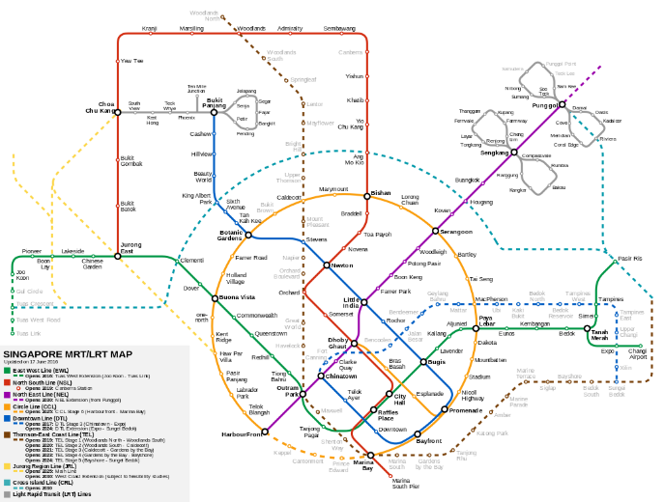

Graph Terminology
Application Areas
Maps
V = {stations}
E = {underground route}
Electrical circuits
V = {electrical devices}
E = {linkage between devices}
References:
Aforl. (2014). A map of Singapore’s Mass Rapid Transit (MRT) and Light Rail Transit (LRT) systems [Image]. Retrieved from https://commons.wikimedia.org/wiki/File:Singapore_MRT_and_LRT_System_Map.svg
File: Electric circuit [Image]. (2013). Retrieved from https://pixabay.com/en/board-chip-circuit-electric-158973
Notes:
Here are some examples for the application of graphs. First, a map can be represented as a graph, in which the vertices are the train stations in the MRT (mass rapid transit) system of Singapore, and the edges are the underground route.
Also, we can use graphs to represent electrical circuits. Here the vertices are electrical devices, and the edges represent linkage between the devices.

Slide 11
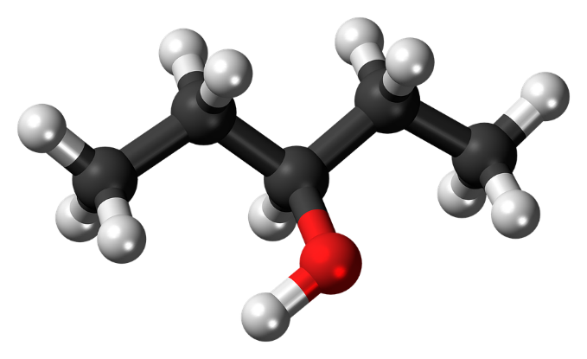
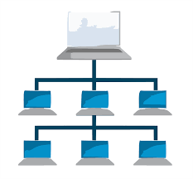
Graph Terminology
Application Areas
Organic Chemistry
V = {atoms}
E = {bonds between atoms}
Computer Networks
V = {computers}
E = {connections between computers}
References:
Chemistry-atoms [Image]. (2015). Retrieved from https://pixabay.com/en/pentanol-molecule-chemistry-atoms-867210/
Network tiered LAN server [Image]. (2014). Retrieved from https://pixabay.com/en/computer-network-tiered-lan-server-311339/
Notes:
In organic chemistry, the vertices are atoms and edges are bonds between atoms. In computational chemistry, scientists use graph algorithms to search for interesting patterns in the chemical structures.
Of course, the computer networks which are familiar to us are also represented by graphs. The vertices correspond to computers and the edges are connections between computers in the network. So you can see that the mathematical concept of graphs has broad applications in many different fields.

Slide 12
Graph Representations
Notes:
After we have reviewed the terminology of graphs, let us think about how to represent a graph inside a computer. Since in some real applications, the graphs could be huge, consisting of millions even billions of nodes, data structures for the graphs should be very efficient. Here we introduce two types of graph representation

Slide 13
Graph Representations
Adjacency Matrix Representation
Declare a 2-D array: int A[N][N]; /*N is no. of nodes*/
Edge (u, v) ∈ E implies A[u][v] == 1; otherwise, A[u][v] == 0.
If a graph is directed, then A[u][v] == 1 iff (u, v)∈E; it does not imply (v, u) ∈ E.
If a graph is undirected, then A is symmetric, i.e., A[u][v] == A[v][u].
Notes:
Here we introduce two types of graph representation. The first is called the “adjacency matrix”.
Basically it is a two-dimensional array of N rows and N columns, where N is the number of vertices in a graph. Here is how the structure of a graph can map to the data in an adjacency matrix.
If there is an edge between vertices u and v, then the corresponding entry in the matrix will be set to 1. The entry for the edge is located at the row corresponding to vertex u, and at the column corresponding to vertex v of the matrix. Otherwise we will put 0 to the entry.
If the graph is directed, then the order of two vertices for an edge will matter. So for the edge from u to v, we will put the entry at u-th row and v-th column to 1. But it does not mean that the edge from v to u exists in the graph; for that we need to check the entry at v-th row and u-th column.
For an undirected graph, the adjacency matrix should be symmetric. That means, A[u][v] should be equal to A[v][u]. Either both are 1 or both are 0, because the order of two vertices doesn’t matter for an edge in an undirected graph.
The strength of the adjacency matrix is that it takes only constant time to access an entry (or an edge) when the indices of the vertices are given. This is because an adjacency matrix is implemented as a two-dimensional array.
However, you might waste space if the graph is sparse, which means there are not many edges. Even so, we still need |V|² entries, where |V| is the number of vertices. A lot of entries will contain zeros, meaning that the two vertices are not connected.

Slide 14
Graph Representations
Adjacency Matrix Representation
Performance:
Good because access time for A[u][v] is constant.
Bad when graph is sparsely connected, i.e., most of the entries in A are zeros (|E| « |V|²).
Notes:
The strength of the adjacency matrix is that it takes only constant time to access an entry (or an edge) when the indices of the vertices are given. This is because an adjacency matrix is implemented as a two-dimensional array.
However, you might waste space if the graph is sparse, which means there are not many edges. Even so, we still need |V|² entries, where |V| is the number of vertices. A lot of entries will contain zeros, meaning that the two vertices are not connected.

Slide 15
Graph Representations
Undirected Graph
4
12
11
1
8
3
2
5
6
7
9
10
Notes:
For example, we have here an undirected graph. Then, how to represent it using an adjacency matrix?

Slide 16
Graph Representations
Adjacency Matrix Representation
 | 1 | 2 | 3 | 4 | 5 | 6 | 7 | 8 | 9 | 10 | 11 | 12
1 | 0 | 1 | 1 | 1 | 0 | 0 | 0 | 0 | 0 | 0 | 1 | 0
2 | 1 | 0 | 0 | 0 | 1 | 1 | 0 | 0 | 0 | 0 | 1 | 0
3 | 1 | 0 | 0 | 0 | 0 | 0 | 1 | 1 | 0 | 0 | 0 | 0
4 | 1 | 0 | 0 | 0 | 0 | 0 | 0 | 0 | 0 | 0 | 0 | 0
5 | 0 | 1 | 0 | 0 | 0 | 0 | 0 | 0 | 0 | 0 | 0 | 0
6 | 0 | 1 | 0 | 0 | 0 | 0 | 0 | 0 | 1 | 1 | 0 | 0
7 | 0 | 0 | 1 | 0 | 0 | 0 | 0 | 0 | 0 | 0 | 0 | 0
8 | 0 | 0 | 1 | 0 | 0 | 0 | 0 | 0 | 0 | 0 | 0 | 1
9 | 0 | 0 | 0 | 0 | 0 | 1 | 0 | 0 | 0 | 0 | 0 | 0
10 | 0 | 0 | 0 | 0 | 0 | 1 | 0 | 0 | 0 | 0 | 0 | 0
11 | 1 | 1 | 0 | 0 | 0 | 0 | 0 | 0 | 0 | 0 | 0 | 0
12 | 0 | 0 | 0 | 0 | 0 | 0 | 0 | 1 | 0 | 0 | 0 | 0
Lower left triangle is symmetric with upper right one.
Notes:
This is how the adjacency matrix looks like for the undirected graph we have just seen. Given this matrix, can you draw the corresponding graph? This is an exercise for you guys. Here, because the graph is undirected, the matrix is symmetric. In other words, the lower triangle and the upper triangle are similar to each other like looking in the mirror.
The mirror is the diagonal of the matrix.
For example, the entry at the 7th row and 3rd column is equal to the entry at the 3rd row and 7th column, where both are equal to 1.

Slide 17
Graph Representations
Array of Adjacency Lists
Use an array to represent the vertices
For each vertex, use a linked list to represent the connections to other vertices
Commonly used, flexible structure
If the edges have different weights, they can be stored in the nodes of the linked lists
Notes:
The second graph representation is called the “array of adjacency lists”.
The idea is that we use an array to represent the vertices, where each entry of the array corresponds to a vertex in the graph.
Then, for each vertex, we use an adjacency list to represent which other vertices are connected with this vertex. In other words, the neighbours of a vertex will be put in the linked list following the array entry corresponding to that vertex.
This is a flexible data structure. Why? Because the length of an adjacency list is not fixed, but is dependent on the actual connectivity of a vertex. If two vertices are not connected, we don’t need to represent their relation in the linked list at all.
In addition, we can store additional information, such as the edge weights, into the linked list nodes. Note that, here the node does not mean the vertex in a graph, but a node structure in a linked list.

Slide 18
Graph Representations
Array of Adjacency Lists
Based on the same undirected graph seen earlier:
1
2
3
4
5
6
7
8
9
10
11
12
→ 2 → 3 → 4 → 11
→ 11 → 1 → 5 → 6
→ 1 → 8 → 7
11
4
12
→ 1
→ 2
1
→ 10 → 9 → 2
8
→ 3
3
→ 12 → 3
2
→ 6
5
6
7
→ 6
→ 2 → 1
9
10
→ 8
Notes:
So for the same graph as we have seen earlier, this is the representation using an array of adjacency lists.

Slide 19
Graph Representations
Array of Adjacency Lists
Based on the same undirected graph seen earlier:
1
2
3
4
5
6
7
8
9
10
11
12
→ 2 → 3 → 4 → 11
→ 11 → 1 → 5 → 6
→ 1 → 8 → 7
11
4
12
→ 1
→ 2
1
→ 10 → 9 → 2
8
→ 3
3
→ 12 → 3
2
→ 6
5
6
7
→ 6
→ 2 → 1
9
10
→ 8
Notes:
For example, since vertex 1 is connected with vertices2, 3, 4 and11, the four neighbors of vertex 1 are all recorded in the linked list for the first entry of the array. Later, if you want to add a weight to each edge, then you can record the weight in the corresponding linked list node. Actually, we can also add edge weight in the adjacency matrix, by replacing 1 with the value of edge weight.

Slide 20
Graph Representations
Array of Adjacency Lists
Based on the same undirected graph seen earlier:
1
2
3
4
5
6
7
8
9
10
11
12
→ 2 → 3 → 4 → 11
→ 11 → 1 → 5 → 6
→ 1 → 8 → 7
11
4
12
→ 1
→ 2
1
→ 10 → 9 → 2
8
→ 3
3
→ 12 → 3
2
→ 6
5
6
7
→ 6
→ 2 → 1
9
10
→ 8
Notes:
For the array of adjacency lists, because the graph is undirected, we represent each edge twice in the data structure.

Slide 21
Graph Representations
Array of Adjacency Lists
Based on the same undirected graph seen earlier:
1
2
3
4
5
6
7
8
9
10
11
12
→ 2 → 3 → 4 → 11
→ 11 → 1 → 5 → 6
→ 1 → 8 → 7
11
4
12
→ 1
→ 2
1
→ 10 → 9 → 2
8
→ 3
3
→ 12 → 3
2
→ 6
5
6
7
→ 6
→ 2 → 1
9
10
→ 8
Notes:
For example, the edge between vertex 3 and vertex 7, is recorded
once in the linked list for vertex 3, and once again in the linked list for vertex 7.
In a directed graph, however, each directed edge will be represented only once in the linked lists.

Slide 22
Graph Representations
Array of Adjacency Lists
Based on the same undirected graph seen earlier:
1
2
3
4
5
6
7
8
9
10
11
12
→ 2 → 3 → 4 → 11
→ 11 → 1 → 5 → 6
→ 1 → 8 → 7
11
4
12
→ 1
→ 2
1
→ 10 → 9 → 2
8
→ 3
3
→ 12 → 3
2
→ 6
5
6
7
→ 6
→ 2 → 1
9
10
→ 8
Notes:
So we have learned two data structures for representing graphs,

Slide 23
Graph Representations
Adjacency Matrix
Array of Adjacency Lists
 | 1 | 2 | 3 | 4 | 5 | 6 | 7 | 8 | 9 | 10 | 11 | 12
1 | 0 | 1 | 1 | 1 | 0 | 0 | 0 | 0 | 0 | 0 | 1 | 0
2 | 1 | 0 | 0 | 0 | 1 | 1 | 0 | 0 | 0 | 0 | 1 | 0
3 | 1 | 0 | 0 | 0 | 0 | 0 | 1 | 1 | 0 | 0 | 0 | 0
4 | 1 | 0 | 0 | 0 | 0 | 0 | 0 | 0 | 0 | 0 | 0 | 0
5 | 0 | 1 | 0 | 0 | 0 | 0 | 0 | 0 | 0 | 0 | 0 | 0
6 | 0 | 1 | 0 | 0 | 0 | 0 | 0 | 0 | 1 | 1 | 0 | 0
7 | 0 | 0 | 1 | 0 | 0 | 0 | 0 | 0 | 0 | 0 | 0 | 0
8 | 0 | 0 | 1 | 0 | 0 | 0 | 0 | 0 | 0 | 0 | 0 | 1
9 | 0 | 0 | 0 | 0 | 0 | 1 | 0 | 0 | 0 | 0 | 0 | 0
10 | 0 | 0 | 0 | 0 | 0 | 1 | 0 | 0 | 0 | 0 | 0 | 0
11 | 1 | 1 | 0 | 0 | 0 | 0 | 0 | 0 | 0 | 0 | 0 | 0
12 | 0 | 0 | 0 | 0 | 0 | 0 | 0 | 1 | 0 | 0 | 0 | 0
1
2
3
4
5
6
7
8
9
10
11
12
→ 2 → 3 → 4 → 11
→ 11 → 1 → 5 → 6
→ 1 → 8 → 7
→ 1
→ 2
→ 10 → 9 → 2
→ 3
→ 12 → 3
→ 6
→ 6
→ 2 → 1
→ 8
Notes:
Namely adjacency matrix and an array of adjacency lists.
For a certain application, it is important to make the right choice of data structure for graphs, to achieve optimal time and space efficiency. We will come back to this question when we learn about other graph algorithms in the future.

Slide 24
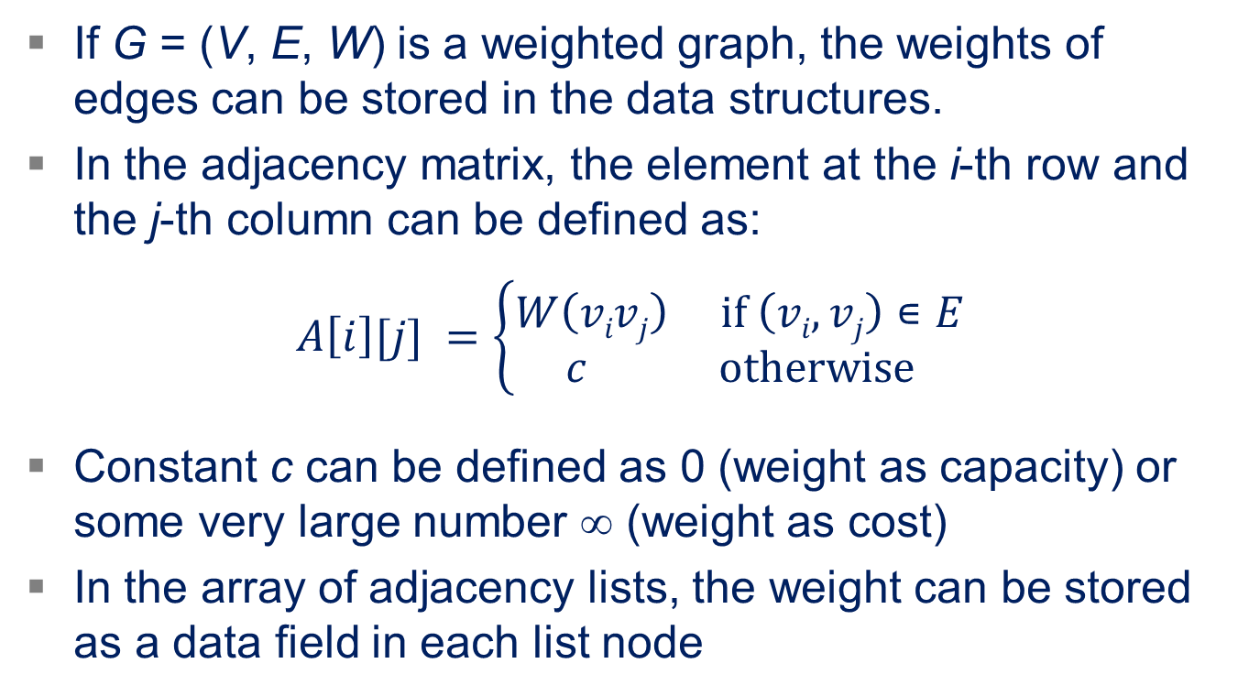
Represent Weighted Graphs
If G = (V, E, W) is a weighted graph, the weights of edges can be stored in the data structures.
In the adjacency matrix, the element at the i-th row and the j-th column can be defined as:
$$A\left[i\right][j] =\left\{\begin{aligned}W\left(vivj\right) if \left(vi,vj\right)∊E \\ c otherwise\end{aligned}\right.$$
Constant c can be defined as 0 (weight as capacity) or some very large number ∞ (weight as cost)
In the array of adjacency lists, the weight can be stored as a data field in each list node

Slide 25
Example of Weighted Graph
25
1
2
10
5
14
6
3
4
18
 | 1 | 2 | 3 | 4
1 | 0 | 25 | 0 | 0
2 | 0 | 0 | 10 | 14
3 | 5 | 0 | 0 | 0
4 | 0 | 6 | 18 | 0
1
2
3
4
→ (2, 25)
→ (3, 10) → (4, 14)
→ (1, 5)
→ (2, 6) → (3, 18)

Slide 26
Summary
This lecture is a basic introduction to graphs
Concepts and terminologies of graph, such as
A graph consists of a set of vertices and a set of edges
Directed vs. undirected graphs
The definitions of path and cycle, etc.
Two data structures used to represent graphs:
Adjacency matrix
Array of adjacency lists
Their advantages and disadvantages for different applications
Notes:
In this lecture we have learned the basic introduction to graphs, which includes the terminologies of graphs and
two data structures to represent graphs in computers.
Some of the terminologies of graphs have been taught in prerequisite courses like discrete mathematics and
data structures, so in a sense this is a review of what we have learned about graphs.
For example, we know that a graph comprises two sets of objects, namely the set of vertices and the set of edges.
The sizes of the two sets, that is, the number of vertices and the number of edges, represent the size of a graph;
hence they will be used as the key parameters for complexity analysis of graph algorithms.
Also, there are basically two categories of graphs, directed and undirected. The same terminology may have slightly
different meanings for the two types of graphs.
We have learned the definitions of other terminologies, such path and cycle. They are objects
to be searched by some algorithms, such as algorithms to find the shortest path between two vertices in a graph,
as we will learn later. We should not only understand and memorize the meanings of the terminologies, but also
get familiar with them, so that we can use them accurately and fluently in communications, as part of our language.
Then, in the second half, we have learned two methods to represent graphs using data structures.
One data structure is the adjacency matrix. The main idea is that, each row corresponds to a vertex,
each column also corresponds to a vertex, and the entry of the i-th row and the j-th column represents the
connectivity between the i-th vertex and the j-th vertex. If they are connected (that is, adjacent), we
put 1 in the entry; otherwise, we put 0. For a weighted graph, then we can assign the value of the weight of
an edge to the corresponding entry of the adjacency matrix.
The second data structure is the array of adjacency lists. Here, each vertex corresponds to an entry of an array,
and each entry of the array will point to a linked list that contains the information of neighbours of
the vertex. Note that, each neighbour also corresponds to an edge incident with the vertex.
Other information about edges, such as the weights, can also be stored in the linked list nodes.
As computer scientists or engineers, we often need to choose, among different algorithms or data structures, the best one
according to the needs. Here, for different graphs or requirement for algorithms, we should be able to choose between the
two graph representation methods. Since an adjacency matrix is typically implemented with a two-dimensional array, it is
very fast to search for an edge if its two end vertices are known. However, if a graph is sparse, that is, has a small number
of edges, then the adjacency matrix could waste space and time, because even if two vertices are not connected, there will be
still an entry that contains 0 in the matrix. By contrast, the array of adjacency lists would be more flexible. If two vertices are
not connected, that is, there is no edge between them, then the adjacency lists won’t waste any space for the pair of vertices.
Instead, there will be only space to represent edges that do exist in the graph. This will often save time as well, since some
algorithms require us to scan the neighbors of each vertex, as we will see in the next lecture on graph traversal.
In short, the graph terminologies and representations form the foundation of graph; therefore, I suggest you to consult the
notes of this lecture in your future learning of graph algorithms.

